Slide 1
SIC030 - PPT - SESI ke 10 Sistem Perdagangan Elektronik
E-Commerce Strategy and Global EC
M HANIF JUSUF ST MKOM

Slide 2
Learning Objectives
Describe the strategic planning process.
Understand how e-commerce impacts the strategic planning process.
Understand how EC applications are formulated, justified, and prioritized.
Describe strategy implementation and assessment, including the use of metrics.

Slide 3
Learning Objectives (cont.)
Understand the causes of EC failures and lessons for success.
Evaluate the issues involved in global EC.
Analyze the impact of EC on small businesses.

Slide 4
Lonely Planet Travels from Place to Space
The Problem
Independent travelers depend on a Lonely Planet guidebook to:
Help them get to their destination
Where to sleep
The best places to eat
What to see and do
At a price they can afford

Slide 5
Lonely Planet Travels from Place to Space (cont.)
LP’s principal assets are:
global brand name
dedication of its writers and editorial staff
vast library of text, maps, photos, and images
community of global travelers who buy LP products and contribute to the company’s knowledge base

Slide 6
Lonely Planet Travels from Place to Space (cont.)
LP has been successful in the physical marketplace and is now migrating to the electronic marketspace, it must:
Apply electronic technologies to its vast library of travel information to reinvent the travel guide

Slide 7
Lonely Planet Travels from Place to Space (cont.)
Sell its content electronically and not create channel conflicts
Make changes in the way it collects information, stores it, and uses it to publish travel guides

Slide 8
Lonely Planet Travels from Place to Space (cont.)
The Solution
LP’s current combination of business models that make up value proposition and revenue model:
Content provider
Virtual community
Direct to consumer

Slide 9
Lonely Planet Travels from Place to Space (cont.)
Online LP launched these initiatives:
online store (LP shop), access to brief destination overviews
free updates to currently published guides
various forms of travel news
a traveler’s bulletin board
links to related sites

Slide 10
Lonely Planet Travels from Place to Space (cont.)
eKno (ekno.lonelyplanet.com) is a joint venture with eKit.com to provide an interactive communications service for international travelers
CitySyn (citysync.com) is branded “the personal digital guide to urban adventure.” It allows owners of handheld computers to load their devices with LP city guides

Slide 11
Lonely Planet Travels from Place to Space (cont.)
Knowledge Bank is an internal knowledge management project that aims to transfer all of LP’s intellectual property into a standardized and centralized digital database
knowledge

Slide 12
Lonely Planet Travels from Place to Space (cont.)
The Results
Lonely Planet seeks to use the Internet to “reinvent the travel guide”
Award-winning Web site offers a successful sales and information distribution channel to its customer base

Slide 13
Lonely Planet Travels from Place to Space (cont.)
LP must decide how to generate revenue and further promote its branded products, but at the same time avoid channel conflict and ally anxiety
Knowledge Bank
increased internal efficiencies in information handling
offers numerous long-term business possibilities

Slide 14
Lonely Planet Travels from Place to Space (cont.)
What we can learn…
Marketplace-to-marketspace strategies
Takes the company’s core business and envisions its future in Cyberspace
LP avoided schemes outside its scope

Slide 15
Lonely Planet Travels from Place to Space (cont.)
Initiatives are incremental steps into the marketspace
Strategic experiments that have not distracted the company from its core business
Leadership from the top is essential
Successfully avoided channel conflict and ally alienation

Slide 16
Organizational Strategy
Strategy: A broad-based formula for how a business is going to compete, what its goals should be, and what plans and policies will be needed to carry out those goals
Strategy is also about making tough decisions about what not to do

Slide 17
Organizational Strategy (cont.)
Profitability and economic value is determined by establishing a unique value proposition
Strategy is focused on questions about:
organizational fit
trade-offs
profitability
value

Slide 18
Organizational Strategy (cont.)
E-commerce strategy (e-strategy): The formulation and execution of a vision for how a new or existing company intends to do business electronically

Slide 19
Organizational Strategy (cont.)
The process of strategy:
Initiation
Formulation
Implementation
Assessment

Slide 20
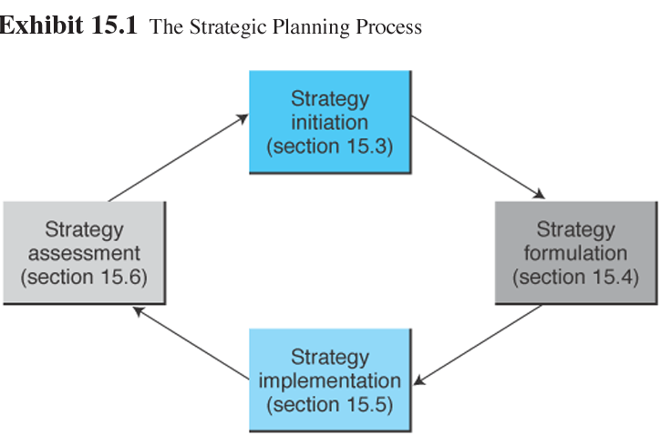
Organizational Strategy (cont.)

Slide 21
Organizational Strategy (cont.)
Strategic planning process
Strategy initiation: The initial phase of strategic planning in which the organization examines itself and its environment
Value proposition: The benefit that a company’s products or services provide to customers; the consumer need that is being fulfilled

Slide 22
Organizational Strategy (cont.)
Outcomes from strategy initiation phase
Company analysis (including value proposition)
Core competencies
Forecasts
Competitor (industry) analysis

Slide 23
Organizational Strategy (cont.)
Strategy formulation: The development of strategies to exploit opportunities and manage threats in the business environment in light of corporate strengths and weaknesses

Slide 24
Organizational Strategy (cont.)
Specific activities and outcomes from strategy formulation phase:
Business opportunities
Cost-benefit analysis
Risk analysis, assessment, and management

Slide 25
Organizational Strategy (cont.)
Strategy implementation: The development of detailed, short-term plans for carrying out the projects agreed on in strategy formulation

Slide 26
Organizational Strategy (cont.)
Specific activities and outcomes from strategy implementation phase:
Business planning
Resource allocation
Project management

Slide 27
Organizational Strategy (cont.)
Strategy assessment: The continuous evaluation of progress toward the organization’s strategic goals, resulting in corrective action and, if necessary, strategy reformulation
Specific measures called metrics are used to assess the progress of the strategy

Slide 28
Organizational Strategy (cont.)
Strategic planning tools
SWOT analysis: A methodology that surveys external opportunities and threats and relates them to internal strengths and weaknesses

Slide 29
Organizational Strategy (cont.)
Strengths
S W O T
Weaknesses
Opportunities
Threats

Slide 30
Organizational Strategy (cont.)
Competitor analysis grid: A strategic planning tool that highlights points of differentiation between competitors and the target firm
Scenario planning: A strategic planning methodology that generates plausible alternative futures to help decision makers identify actions that can be taken today to ensure success in the future

Slide 31
Organizational Strategy (cont.)
Return on investment (ROI): A ratio of required costs and perceived benefits of a project or an application
Balanced scorecard: An adaptive tool that assesses organizational progress toward strategic goals by measuring performance in a number of different areas

Slide 32
EC Strategy: Concepts and Overview
The e-difference
Reach and richness are possible
Barriers to entry are reduced
Virtual partnerships multiply
Interaction costs: The time and money expended when people and companies exchange goods, services, and idea
Market niches abound

Slide 33
EC Strategy (cont.)
Organizational difference
Born-on-the-Net and move-to-the-Net firms both start with substantial assets and liabilities that influence their ability to formulate and execute an e-commerce strategy
The difference between success and failure is the company’s ability to utilize its strengths effectively

Slide 34
EC Strategy Initiation
Issues in e-strategy initiation
Be a first mover or a follower?
Size of the opportunity
Commodity products
Be the best
Go Global?

Slide 35
EC Strategy Initiation Issues
Have a Separate Online Company?
Advantages of creating a separate company
reduction or elimination of internal conflicts
more freedom for the online company’s management in pricing, advertising, etc.
ability to create a new brand quickly
opportunity to build new, efficient information systems that are not burdened by the legacy systems of the old company
influx of outside funding if the market likes the e-business idea and buys the IPO of stock

Slide 36
EC Strategy Initiation Issues (cont.)
Disadvantages of creating an independent division
may be very costly and/or risky
expertise vital to the existing company may be lost to the new firm
new company will not benefit from the expertise and spare capacity in the business functions unless it gets superb collaboration from the parent company

Slide 37
EC Strategy Initiation Issues (cont.)
Have a separate online brand?
Companies with strong, mature, international brands will want to retain and promote that brand online
Firms with a weak brand or a brand that does not reflect the intent of the online effort may decide to create a new brand

Slide 38
EC Strategy Formulation
Common mistakes made in selecting EC projects:
Let a thousand flowers bloom—funding many projects indiscriminately
Bet it all—bets everything on a single high-stakes initiative

Slide 39
EC Strategy Formulation (cont.)
Trend-surf—follow the crowd toward the most fashionable new idea
Being fear- or greed-driven—thinking they can make lots of money by rushing into EC

Slide 40
EC Strategy Formulation (cont.)
Approaches that have propelled strategy formulation:
Problem driven
Technology driven
Market driven

Slide 41
EC Strategy Formulation (cont.)
The e-business maturity model
evaluates online initiatives within the context of established business criteria
designed to help companies think of what’s necessary to implement an e-business solution

Slide 42
EC Strategy Formulation (cont.)
Determining an appropriate EC application portfolio
Internet portfolio map—based on company fit and project viability

Slide 43
EC Strategy Formulation (cont.)
Viability is assessed by:
market value potential
time to positive cash flow
time to implementation
funding requirements

Slide 44
EC Strategy Formulation (cont.)
Fit is evaluated by metrics:
alignment with core capabilities
alignment with other company initiatives
fit with organizational structure
ease of technical implementation

Slide 45
EC Strategy Formulation (cont.)
If both viability and fit are low—the project is rejected
If both are high—the project is adopted
If fit is high but viability is low—the project is redesigned
If the fit is low but the viability is high—the project is sold

Slide 46
EC Strategy Formulation (cont.)
Making a business case
Business case: A written document that is used by managers to garner funding for specific applications or projects by providing justification for investment of resources

Slide 47
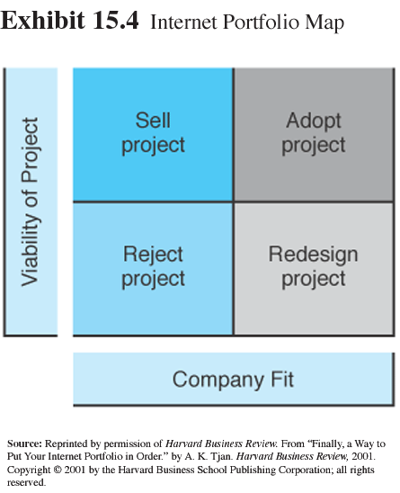
EC Strategy Formulation (cont.)

Slide 48
Cost-Benefit Analysis
Cost-benefit analysis
A valuable planning tool and assists in the development of metric measures that later will be used in strategy assessment
Many of the costs of an EC project can be clearly identified and estimated
costs of hardware, software, new staff, and facilities

Slide 49
Cost-Benefit Analysis (cont.)
Most benefits of an EC project are quite intangible—it is difficult to estimate:
Increased sales from an expanded customer base
Savings from streamlined purchasing procedures
Reduced telecommunications costs

Slide 50
Cost-Benefit Analysis (cont.)
One of the most difficult factors in accurate benefit estimation, especially for start-up companies, is to properly plan the revenue model
revenues from advertising may not materialize
revenue models based on sales depend on large and rapid customer acquisition

Slide 51
Risk Analysis
Risk analysis and management
E-commerce risk: The likelihood that a negative outcome will occur in the course of developing and operating an electronic commerce strategy
The first step in any risk assessment is risk analysis—identifying and evaluating the sources of risk

Slide 52
Risk Analysis (cont.)
Four sources of business risk in an
e-commerce strategy:
Competitive risk
Transition risk
Customer-induced risk
Business partner risk

Slide 53
Risk Analysis (cont.)
The next step is risk management—to put in place a plan that reduces the threat posed by the risk
Taking steps to:
reduce the probability that the threat will occur
minimizing the consequences if it occurs anyway
both

Slide 54
Issues in Strategy Formulation
Issues in strategy formulation
How to handle channel conflict
Let the established distributors handle e-business fulfillment
Provide online services to intermediaries
Sell some products only online, other products may be advertised online but sold exclusively off-line
Not selling online

Slide 55
Issues in Strategy Formulation (cont.)
How to handle conflict between the off-line and online businesses
The allocation of resources between off-line and online activities can create difficulties
It is essential that top management support both
off-line and online operations
a clear strategy of “what and how” each unit will operate are essential

Slide 56
Issues in Strategy Formulation (cont.)
Pricing strategy
Price comparison is easier
Buyers sometimes set the price
Online and off-line goods are priced differently
Differentiated pricing can be a pricing strategy
versioning: Selling the same good, but with different selection and delivery characteristics

Slide 57
EC Strategy Implementation
Creating a Web team
Project champion: The person who insures the EC project gets the time, attention, and resources required, as well as defending the project from detractors at all times

Slide 58
EC Strategy Implementation (cont.)
Starting a pilot project
Implementing EC often requires significant investments in infrastructure
a good way to start is to undertake one or a few small EC pilot projects
pilot projects help uncover problems early, when the plan can be easily modified before significant investments are made

Slide 59
EC Strategy Implementation (cont.)
Allocating resources
The resources required for the EC projects depend on information requirements and capabilities of each project
Some resources will be new and unique to the project or application
Even more critical for the project’s success is effective allocation of infrastructure resources that are shared by many applications

Slide 60
Application Development
Application development
Should site development be done internally, externally, or in combination?
Should the software application be built or will commercially-available software be satisfactory?

Slide 61
Application Development (cont.)
If a commercial package will suit, should it be purchased from the vendor or rented from an ASP?
Will the company or an external ISP host the Web site?
If hosted externally, who will be responsible for monitoring and maintaining the information and system?

Slide 62
EC Strategy Implementation Issues
Partners’ strategy
Outsourcing: The use of a third-party vendor to provide all or part of the products and services that could be provided internally

Slide 63
EC Strategy Implementation Issues (cont.)
Virtual corporation
Virtual corporation: An organization composed of several business partners sharing costs and resources for the production or utilization of a product or service

Slide 64
EC Strategy Implementation Issues (cont.)
Major attributes of a VC:
Excellence
Utilization
Trust
Lack of borders
Opportunism
Adaptability to change
Technology

Slide 65
EC Strategy Implementation Issues (cont.)
Alliances in e-commerce
Partners in different locations communicate and collaborate online
When EC initiatives are too large and complex for one company to undertake
A strategic partner should be one that has the ability to deliver and is willing to collaborate to provide a service

Slide 66
EC Strategy Implementation Issues (cont.)
Redesigning business processes
Organizational transformation: the process of changing an organization to a new mode of operation
Business process reengineering (BPR): A methodology for conducting a comprehensive redesign of an enterprise’s processes

Slide 67
EC Strategy Implementation Issues (cont.)
BPR may be needed:
To fix poorly designed processes
To change processes so that they will fit commercially available software
To produce a fit between systems and processes of different partner companies
To align procedures and processes with e-services

Slide 68
E-Strategy and Project Assessment
Objectives of assessment
Measure the extent to which the EC strategy and ensuing projects are delivering what they were supposed to deliver
Determine if the EC strategy and projects are still viable in the current environment

Slide 69
Project Assessment Objectives
Reassess the initial strategy in order to learn from mistakes and improve future planning
Identify failing projects as soon as possible and determine why they failed to avoid the same problems on subsequent projects

Slide 70
E-Strategy and Project Assessment (cont.)
Measuring results and using metrics
Metric: A specific, measurable standard against which actual performance is compared

Slide 71
E-Strategy and Project Assessment (cont.)
Metrics can:
Define the value proposition of the business model
Communicate the strategy to the workforce through performance targets
Increase accountability when metrics are linked to performance-appraisal programs
Align the objectives of individuals, departments, and divisions to the enterprise’s strategic objectives actual performance is compared

Slide 72
E-Strategy and Project Assessment (cont.)
Axon metrics implementation obtained results in:
Revenue growth
Cost reduction—selling costs and expenditures
Cost avoidance
Customer fulfillment
Customer service
Customer communications

Slide 73
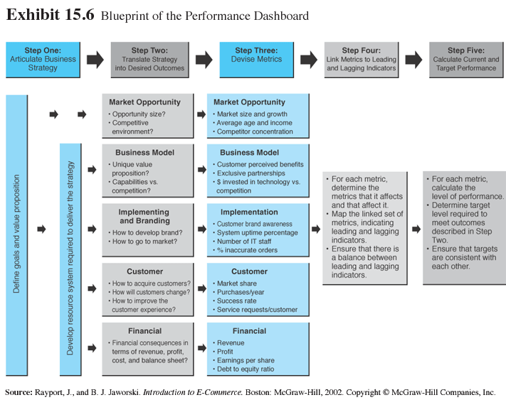
E-Strategy and Project Assessment (cont.)

Slide 74
Keys to EC Success
E-commerce failures
Macro economic level: The technological revolution posed by the Internet should be expected to go through a boom-and-bust-and-consolidation cycle like the automobile and railroad industries

Slide 75
Keys to EC Success (cont.)
Mid-economic level, the bursting of the dot-com bubble in mid-2000 is consistent with economic downturns that have occurred in property, precious metals, currency, and stock markets

Slide 76
Keys to EC Success (cont.)
Micro-economic level, the “Web rush” reflected an over allocation of scarce resources
venture capital
technical personnel
advertising-driven business models

Slide 77
Keys to EC Success (cont.)
Financial reasons are lack of funding and incorrect revenue models
Lack of funding
Incorrect revenue model

Slide 78
Keys to EC Success (cont.)
E-commerce successes
Brick-and-mortar companies are adding online channels using use organizational knowledge, brand, infrastructure, and other strategic assets
Move to higher quality customers
Change products or services in existing market
Establish an off-line presence

Slide 79
Keys to EC Success (cont.)
CSFs (as per Asian CEOs):
select robust business models
understand the dot-com future
foster e-innovation
carefully evaluate a spin-off strategy
co-brand
employ ex-dot-com staffers
focus on the e-generation

Slide 80
Keys to EC Success (cont.)
The top three factors for successful B2C e-commerce:
effective marketing management
attractive Web site
building strong connections to customers

Slide 81
Keys to EC Success (cont.)
The top three factors for successful B2B e-commerce:
readiness of trading partners
information integration inside the company and in the supply chain
completeness of the application

Slide 82
Keys to EC Success (cont.)
The top three factors for overall, successful e-business:
proper business model
readiness of the firm to become an e-business
internal enterprise integration

Slide 83
Going Global
Benefits and extent of operations
The major advantage of EC is the ability to do business
at any time
from anywhere
at a reasonable cost

Slide 84
Going Global (cont.)
Barriers to global EC
authentication of buyers and sellers
generating and retaining trust
order fulfillment and delivery
security
domain names

Slide 85

Going Global (cont.)
Barriers to global EC
culture
administration
C A G E
geography
economics

Slide 86
Going Global (cont.)
Cultural issues
cultural attributes determine how people interact with companies, agencies, and each other based on:
social norms
local standards
religious beliefs
language

Slide 87
Going Global (cont.)
Administrative issues
National governments and international organizations are working together to find ways to avoid uncoordinated actions and encourage uniform legal standards

Slide 88
Going Global (cont.)
International trade organizations are attempting to reduce EC trade barriers like:
pricing regulations
customs
import/export restrictions
tax issues
product specification regulations
Privacy protection

Slide 89
Going Global (cont.)
Geographical issues
Government tariffs
Customs
Taxation
Major US tax issue imposition by states and local authorities of sales taxes on goods purchased by their residents from out-of-state EC companies

Slide 90
Going Global (cont.)
A major key financial barrier to global EC is electronic payment systems
Although credit cards are widely used in the U.S., many European and Asian customers prefer to complete online transactions with off-line payments

Slide 91
Going Global (cont.)
Breaking down the barriers
Be strategic
Know your audience
Localize
Think globally, act consistently
Value the human touch
Clarify, document, explain
Offer services that reduce barriers

Slide 92
EC in Small- and Medium-Sized Enterprises
SMEs moved onto the Web because they realized there were opportunities in:
marketing
business expansion
business launches
cost cutting
tighter partner alliances

Slide 93
EC in Small- and Medium-Sized Enterprises (cont.)
CSFs for SMEs:
Product is critical
Payment methods must be flexible
Electronic payments must be secure
Capital investment should be kept to a minimum

Slide 94
EC in Small- and Medium-Sized Enterprises (cont.)
Inventory control is crucial
Logistical services must be quick and reliable
High visibility on the Internet
Join an online community
A Web site should provide all the services needed by consumers

Slide 95
EC in Small- and Medium-Sized Enterprises (cont.)
Supporting SMEs
Most countries have a government agency devoted to helping SMEs become more aware of and able to participate in EC
sba.gov
business.gov.au

Slide 96
EC in Small- and Medium-Sized Enterprises (cont.)
Vendors have set up a variety of service centers that typically offer a combination of free information and fee-based support
ibm.com/businesscenter
Microsoft’s bcentral.com
Professional associations, Web resource services
smallbusiness.yahoo.com
workz.com

Slide 97
Managerial Issues
What is the strategic value of EC to the organization?
What are the benefits and risks of EC?
What metrics should we use?
What staffing is required?

Slide 98
Managerial Issues (cont.)
How can we go global?
Can we learn to love smallness?
Is e-business is always beneficial?

Slide 99
Summary
The strategic planning process.
The EC strategic process.
E-strategy initiation and formulation.
E-strategy implementation and assessment.

Slide 100
Summary (cont.)
Understanding failures and learning from them.
Issues in global EC.
Small businesses and EC.

Slide 101

Selesai

